Slide 1

CORESCUE: A Smart Emergency Response and Resource Management
Presented By
AMOGH JOSHI
Neil Gogte Institute of Technology
Department of Computer Science & Engineering (Artificial Intelligence & Machine Learning) Project Work - 2

Slide 2
Contents
Introduction
Project Architecture
Modules
Diagrams
System Architecture
Data Flow Diagrams
UML Diagrams
Others (If any)
References
Queries
Neil Gogte Institute of Technology
Department of Computer Science & Engineering (Artificial Intelligence & Machine Learning) Project Work - 2

Slide 3
Introduction
Corescue enables users to send SOS signals during crises, triggering instant email alerts to nearby responders for timely assistance.
The System utilizes GPS coordinates and the K-nearest neighbors' algorithm to efficiently connect users with the closest available responders.
Relief supply management is integrated, allowing users to request essentials like food and medicine, with real-time backend processing and updates.
Administrators can confirm, manage, and track requests, ensuring optimal resource distribution based on user needs and geographic proximity..
Corescue streamlines emergency coordination by combining communication, logistics, and data analytics into a single, efficient platform.
By reducing delays and enhancing communication, Corescue significantly improves the speed and effectiveness of emergency response efforts..
Neil Gogte Institute of Technology
Department of Computer Science & Engineering (Artificial Intelligence & Machine Learning) Project Work - 2

Slide 4
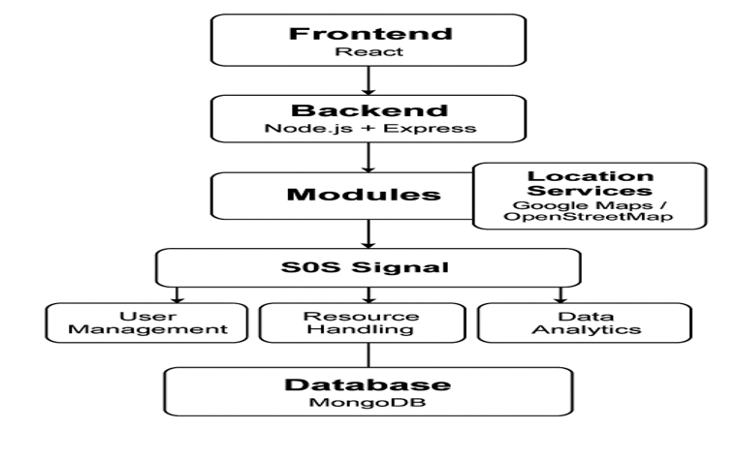
Project Architecture
Neil Gogte Institute of Technology
Department of Computer Science & Engineering (Artificial Intelligence & Machine Learning) Project Work - 2

Slide 5
Module
The Resourse Management module tracks and organizes essential supplies lke food and medical kits, ensuring timely and efficient distribution during crises.
The Order Processing module enables administrators to verify, approve, and dispatch requested relief items while keeping users updates in real time.
The Data Analytics module gathers and analyzes system data to imporove decision-making, predict needs, and enhance future emergency responses.
The User Management module handles user registration, authentication, and role-based access control to ensure secure and personalized user experiences.
The SOS Sgnal module allows users to send distress alerts, which are then forwarded to nearby responders using the k-NN algorithm.
Neil Gogte Institute of Technology
Department of Computer Science & Engineering (Artificial Intelligence & Machine Learning) Project Work - 2

Slide 6
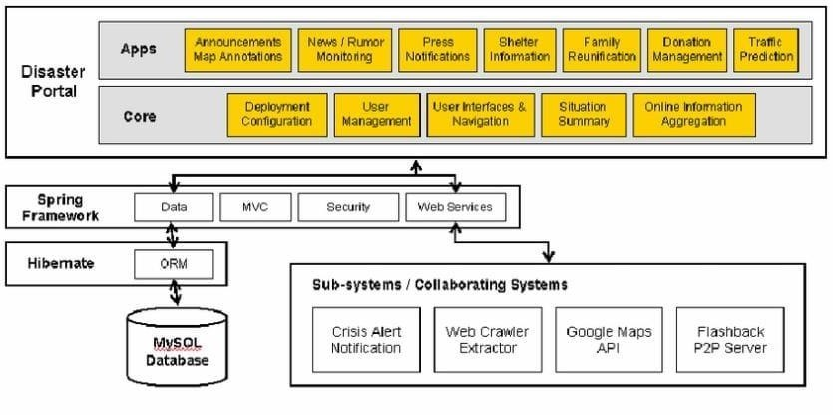
System Architecture
Neil Gogte Institute of Technology
Department of Computer Science & Engineering (Artificial Intelligence & Machine Learning) Project Work - 2

Slide 7
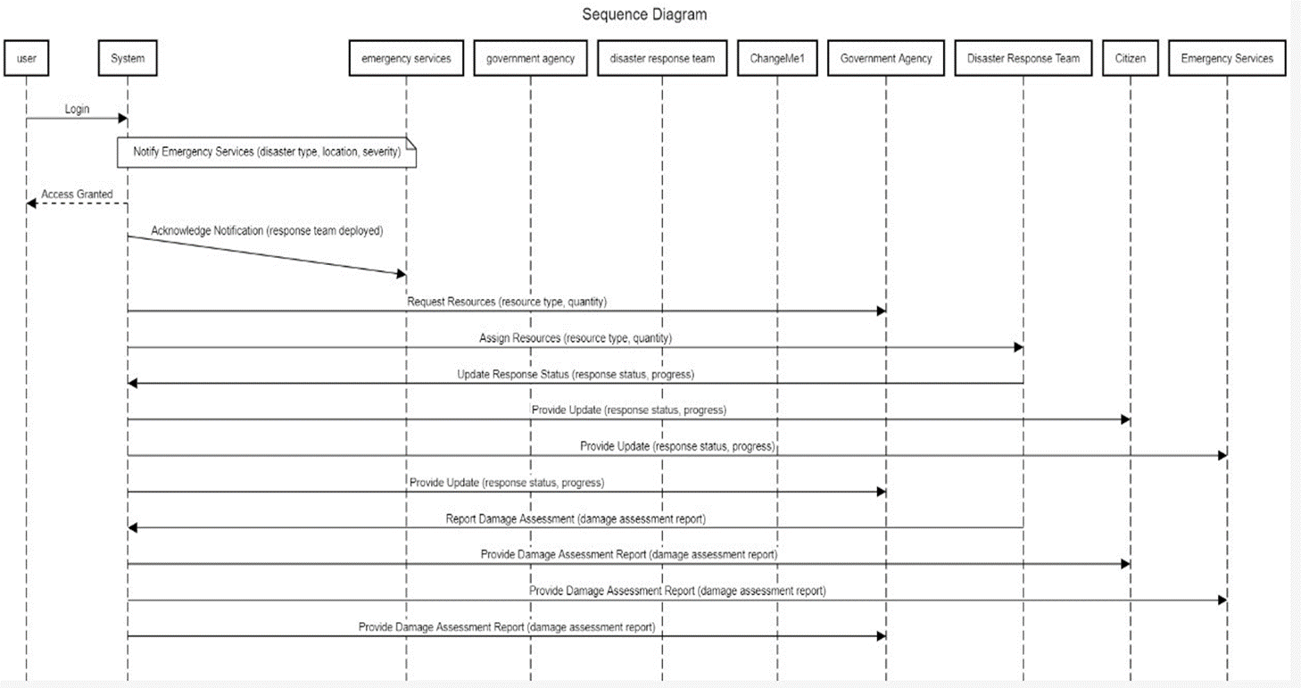
Sequence Diagram
Neil Gogte Institute of Technology
Department of Computer Science & Engineering (Artificial Intelligence & Machine Learning) Project Work - 2

Slide 8
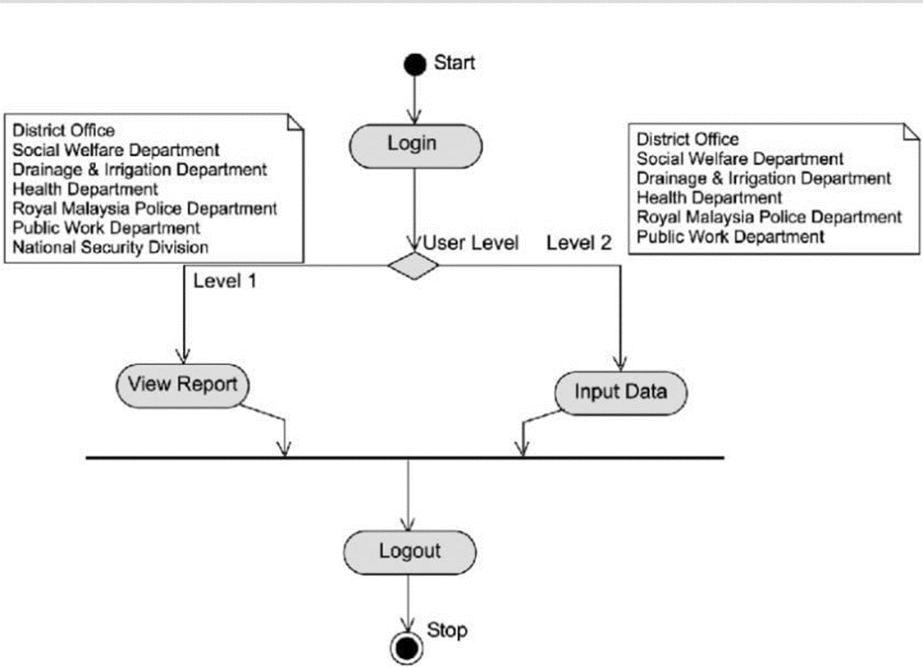
Activity Diagram
Neil Gogte Institute of Technology
Department of Computer Science & Engineering (Artificial Intelligence & Machine Learning) Project Work - 2

Slide 9
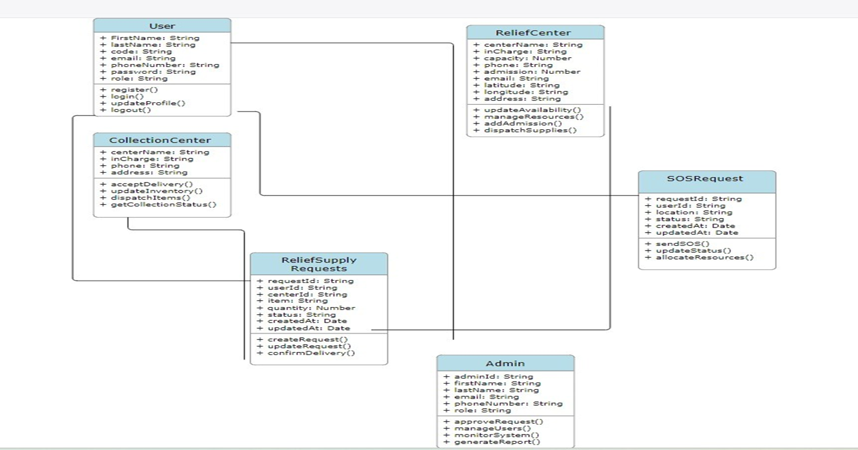
Class Diagram
Neil Gogte Institute of Technology
Department of Computer Science & Engineering (Artificial Intelligence & Machine Learning) Project Work - 2

Slide 10
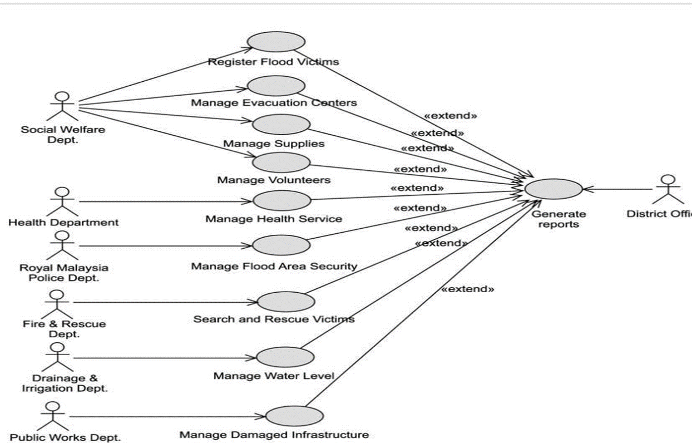
Use Case Diagram
Neil Gogte Institute of Technology
Department of Computer Science & Engineering (Artificial Intelligence & Machine Learning) Project Work - 2

Slide 11
Reference
Emergency Management: Principles and Practice for Local Government by William L. Waugh Jr.
Designing Data-Intensive Applications: The Big Ideas Behind Reliable, Scalable, and Maintainable Systems by Martin Kleppmann.
Web Development with Node and Express: Leveraging the JavaScript Stack by Ethan Brown.
React Up & Running: Building Web Applications by Stoyan Stefanov.
MongoDB: The Definitive Guide: Powerful and Scalable Data Storage by Kristina Chodorow.
"A Survey of Emergency Response Systems and Their Challenges" by Zhang, X., & Zhou, X.
"Scalable Real-Time Location-Based Services with k-Nearest Neighbors Algorithm" by Lee, J., & Kim, H.
"Security Challenges in Web-Based Emergency Response Systems" by Gupta, R., & Sharma, M.
Performance Evaluation of Distributed Systems for Emergency Response" by Smith, A., & Jones, P.
Neil Gogte Institute of Technology
Department of Computer Science & Engineering (Artificial Intelligence & Machine Learning) Project Work - 2

